Slide 1

Deep Learning Models for Breast Cancer Detection Using Mammographic Imaging
Group 4 - Pink Ribboners
Luna Yang
Namratha Bolar
Sai Sruthi Avula
Venkata Naga Sai Sri Vaishavi Appala
Deep Learning (Spring 2025)
Prof. Chengfei Wang

Slide 2
Introduction
Every 1 in 8 women in the United States will develop breast cancer in her lifetime.
310,720 women and 2,800 men are expected to be diagnosed with invasive breast cancer in 2024.
Early cancer detection will reduce emotional distress and improve treatment outcomes.
From 1989 to 2021, advancements in early detection and cancer therapies have significantly improved the outcomes, leading to a remarkable 42% decline in breast cancer-related deaths among women.

Slide 3
Problem Statement
This project aims to develop a deep learning model for breast cancer detection, so we can:
Increase the survival rates by stage at diagnosis
Enhance the effectiveness of different cancer treatments
Eliminate geographic and demographic disparities in breast cancer diagnosis and treatment

Slide 4
Challenges
Imbalanced Data: A significantly higher number of normal breast imaging scans compared to cancerous ones leads to biased model training, reducing detection sensitivity for rare cases.
Multi-Modality Integration: Combining diverse medical imaging techniques (e.g., MRI, X-ray, mammography, histopathology) with computer vision and fusion-based joint transfer learning poses computational and standardization challenges.
Label Noise: Variability in expert annotations and potential mislabeling introduce noise, impacting model generalization and accuracy.

Slide 5
Literature Review 1.1
Spatiotemporal Mammography-based Deep Learning Model for Improved Breast Cancer Risk Prediction By Wadhwa, G., & Kaur, A.
The study aimed to enhance breast cancer risk prediction by integrating spatial and temporal information from mammograms. The paper proposes a spatiotemporal deep learning model using a Siamese neural network to capture risk cues from mammograms collected at different time points (T1 and T2). The Siamese model outperforms conventional CNN-based approaches, achieving an AUC of 0.81, compared to 0.75 (CNN-T1) and 0.77 (CNN-T2). Classical models (e.g., Gail and Tyrer-Cuzick) rely on traditional risk factors but have performance limitations in clinical settings.
Challenges:
The size of the mammogram datasets is limited with multiple screening time points.
Need for models that leverage both spatial and temporal information.
Handling breast density variations

Slide 6
Literature Review 1.2
Model Design:
CNN-T1: CNN trained on baseline screening images.
CNN-T2: CNN trained on follow-up screening images.
Siamese Network: Combines features from both time points (T1 and T2) for spatiotemporal analysis.
Models were trained using a binary cross-entropy loss function, with techniques like dropout and early stopping to improve generalization.
Outcomes:
The Siamese network leverages temporal differences, which help it outperform CNN models that rely solely on spatial data. The model performed well with lower sensitivity typically observed in dense breast images, demonstrating better accuracy in these cases. Younger patients benefited more from the spatiotemporal model, as malignancy features tend to be more dynamic in younger tissues.

Slide 7
Literature Review 2.1
A curated mammography data set for use in computer-aided detection and diagnosis research
The paper discusses the challenges in computer-aided detection (CADe) and diagnosis (CADx) in mammography, emphasizing the lack of a standardized evaluation dataset. Many prior studies have used private or unspecified subsets of public datasets, making it difficult to compare and reproduce results. To address this, the authors propose the CBIS-DDSM (Curated Breast Imaging Subset of the Digital Database for Screening Mammography), an updated and standardized dataset. The CBIS-DDSM includes decompressed images, improved region-of-interest (ROI) segmentations, and structured metadata, making it more accessible for machine learning research.
Challenges:
Lack of Standardized Datasets – Inconsistent data sources and private datasets hinder reproducibility and fair comparison of CADe and CADx models.
Outdated Image Formats & Accessibility Issues – The original DDSM dataset uses obsolete compression, making image processing difficult and requiring decompression for usability.
Imprecise ROI Annotations – Existing lesion annotations lack accuracy, requiring researchers to implement their own segmentation methods, leading to inconsistent results.

Slide 8
Literature Review 2.2
Model Design
Decompression & Reformatting: The CBIS-DDSM dataset converts obsolete LJPEG files into DICOM format, making them compatible with modern medical imaging tools.
Metadata Standardization: The authors extracted and reformatted metadata into structured CSV files for easier access.
Improved Segmentation: A trained mammographer reviewed annotations, and a segmentation algorithm refined ROI outlines, improving lesion delineation.
Training & Testing Splits: Cases were categorized based on BI-RADS scores, ensuring balanced training and test sets for fair evaluation.
Cross-Platform Compatibility: The image processing tools were rewritten in Python, making them more accessible than the original Linux-based scripts
Outcomes:
Higher Quality Data: The CBIS-DDSM dataset offers better ROI segmentations and metadata structuring, making it more useful for CADe and CADx research.
Improved Reproducibility: By providing a publicly available, well-annotated dataset, the study enables direct comparison of different methods.
Benchmark for Future Research: This dataset serves as a new standard for evaluating mammography-based decision support systems.
Segmentation Validation: Comparing automated and hand-drawn segmentations showed that the new approach significantly improved accuracy (Dice coefficient increased from 0.398 to 0.792 on average).
Wider Accessibility: The dataset is available on The Cancer Imaging Archive (TCIA), promoting open research in medical imaging.

Slide 9
CBIS-DDSM Dataset
Curated Breast Imaging Subset of the Digital Database for Screening Mammography (CBIS-DDSM) is a medical imaging dataset for detecting and classifying breast cancer.
The dataset includes expert-annotated mammograms with pathologically confirmed labels.
The dataset comprises 10,239 mammographic images from 6,671 subjects, provided in DICOM format with high-resolution scans.

Slide 10
CBIS-DDSM Dataset
1.Normal Diagnostic Class: No abnormalities detected.
2.Benign Diagnostic Class : Non-cancerous masses or calcifications.
3.Malignant Diagnostic Class: Cancerous abnormalities confirmed through pathology.
Calcifications (753 cases): Tiny deposits of calcium in breast tissue, sometimes indicating early cancer stages.
Masses (891 cases): Lumps or irregular growths, classified as benign or malignant based on biopsy results.

Slide 11
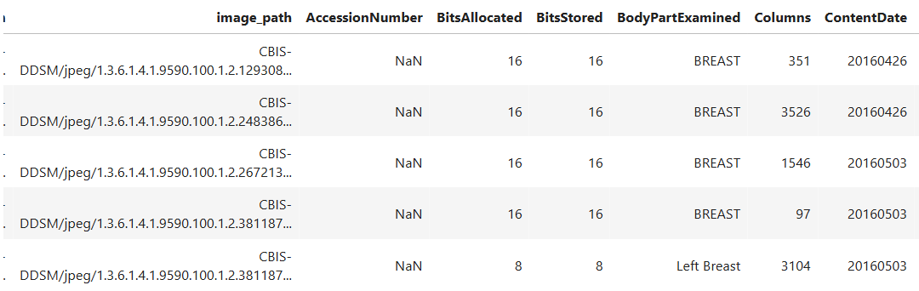
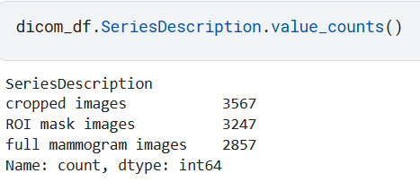
CBIS-DDSM Dataset – Dicom Data
Contains all the image Information

Slide 12
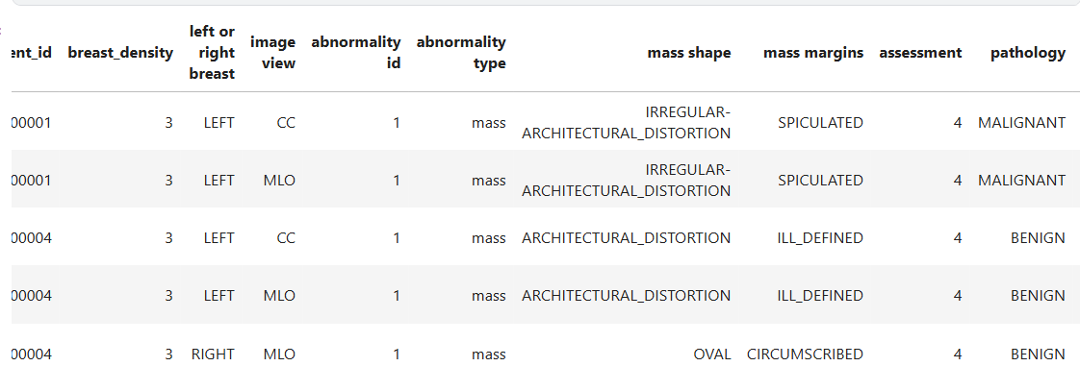
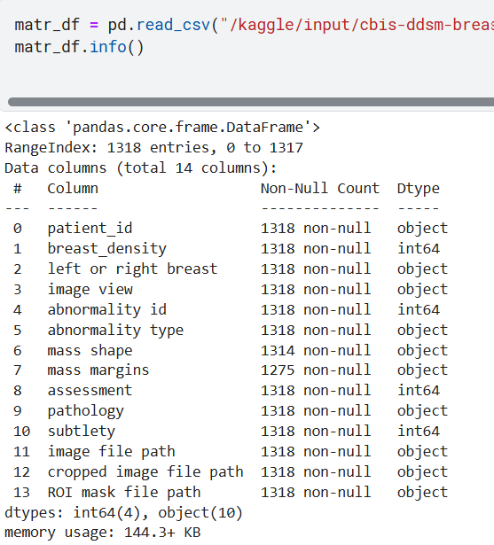
CBIS-DDSM Dataset – Mass Train Data

Slide 13
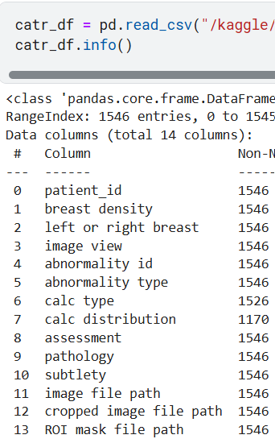
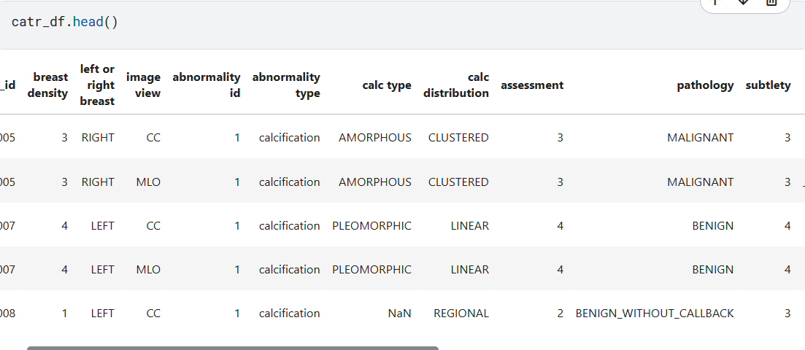
CBIS-DDSM Dataset – Calc Train Data

Slide 14
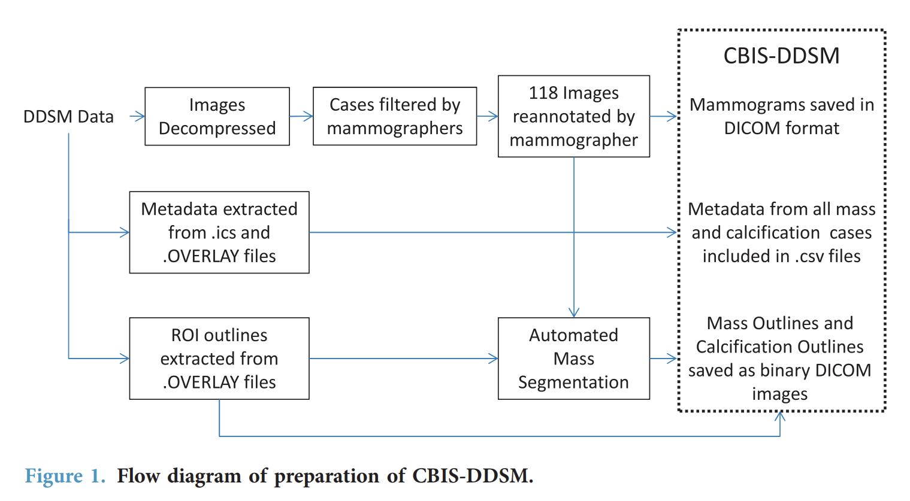

Slide 15
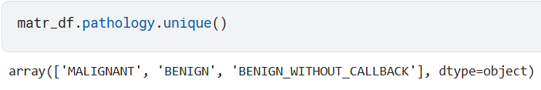
Data Preprocessing & Analysis (Variables & Images )
No missing values and Inappropriate Data
Checked for Unique Pathology:
Class Mapping the Pathology
Image Separation:
1.Length of Cropped Image Dataset: 3567 , full_mammogram : 2857,roi_mask: 3247

Slide 16
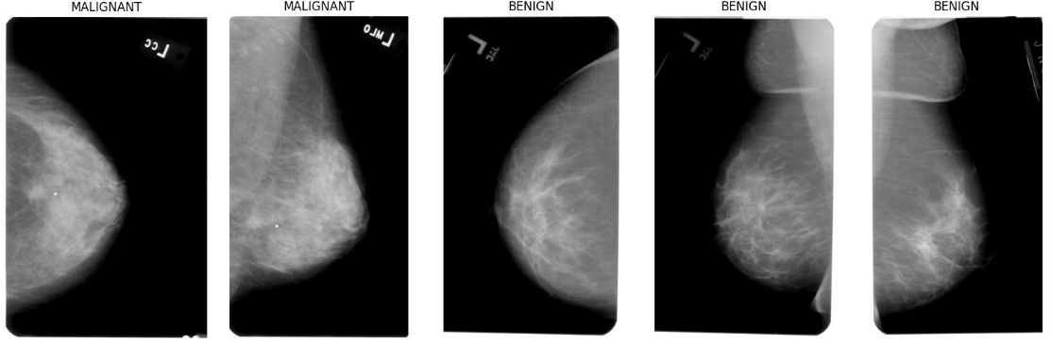
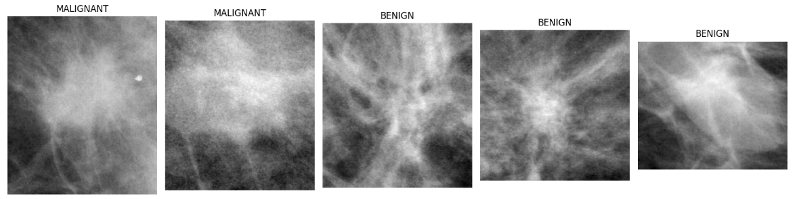
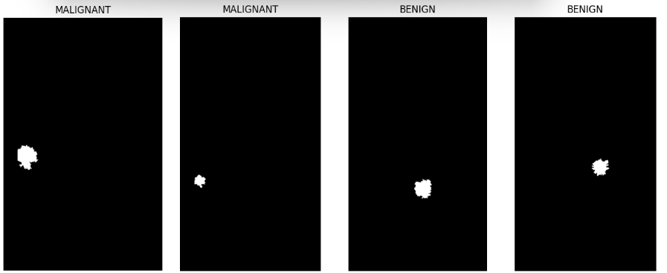
Data Analysis & Visualization- MassesTrain
Full_Mammograms:
Cropped_Mammograms:
ROI_Mask:

Slide 17
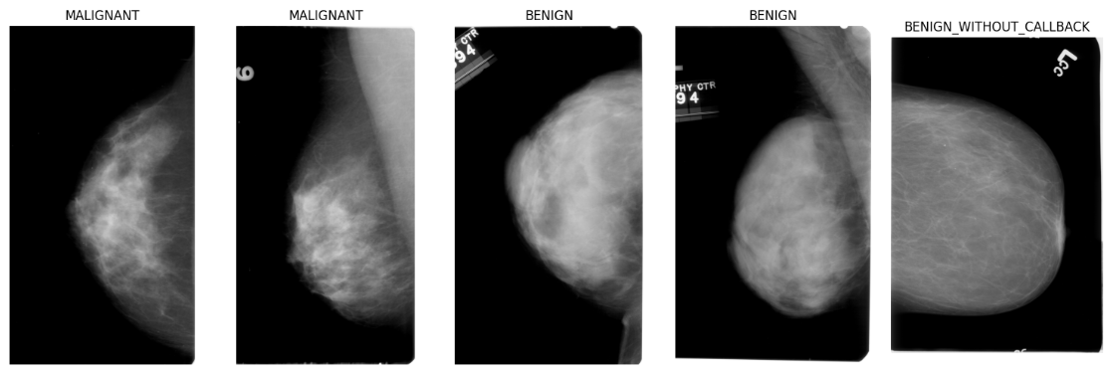
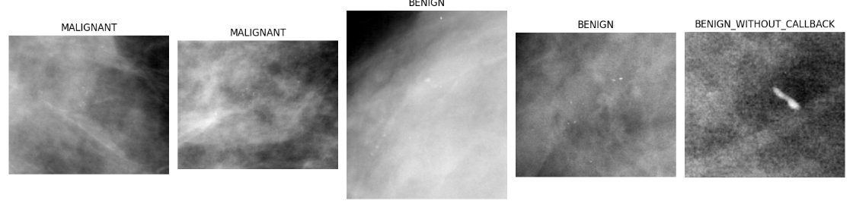
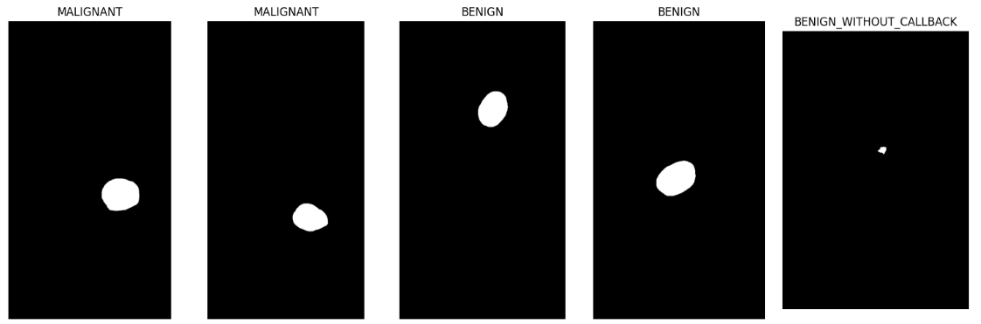
Data Analysis & Visualization- Calc Train
Full_Mammograms:
Cropped_Mammograms:
ROI_Mask:

Slide 18
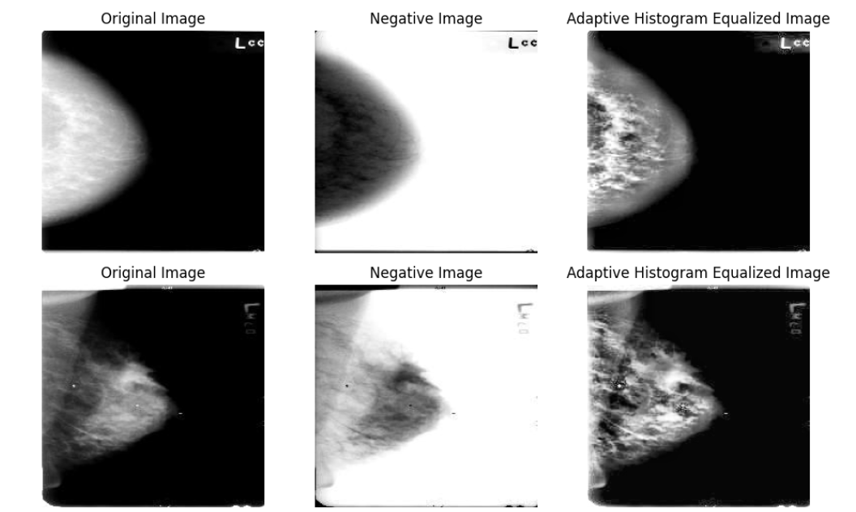
Data Analysis & Visualization- Calc Train
Image augmentation – image flip, brightness, contrast, saturation
Data balancing: maglinent 753 vs. benign 891
Balanced sample: both malignant vs. benign 1018
Image size after balancing: malignant 4986 vs. benign 4988
We yield a total of 9974 images after image augmentation
Converting original images to negative images
Reverses the light and dark tones, allowing you to see details in a different way
Converting original images to adaptive histogram equalization (AHE)
A contrast enhancement technique that improves image quality by adjusting the contrast of different regions of an image
Make cancerous regions more distinguishable from healthy tissue

Slide 19
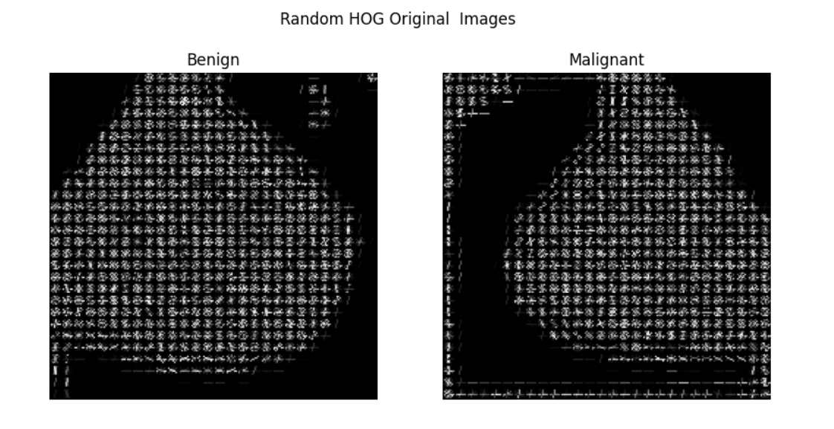
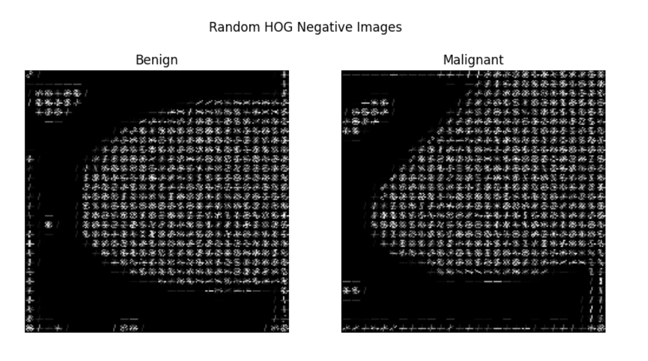
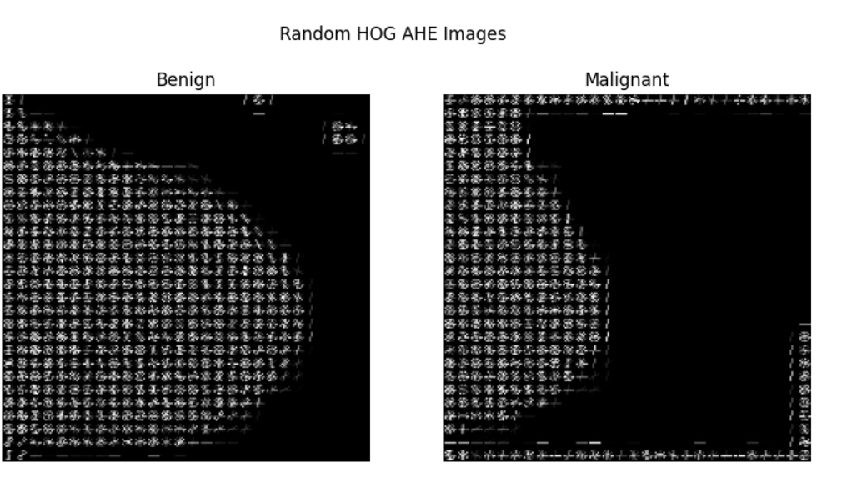
Image Preprocessing
Histogram of oriented gradients compute gradient orientations and magnitudes in localized regions of an image, then aggregating them into histograms
It is effective in highlighting edge structures and textures, which are crucial in detecting tumor boundaries, microcalcifications, and abnormal cell growth

Slide 20
Methodology – Learning Model
Base Model – Conventional Neutral Network (CNN)
ResNet50

Slide 21
CNN
Input
Conv2D(32 filters,3X3,ReLu)
Conv2D(64 filters,3X3,ReLu)
Conv2D(128 filters,3X3,ReLu)
Conv2D(256 filters,3X3,ReLu)
Conv2D(512 filters,3X3,ReLu)
MaxPooling2D(2x2)
Flatten
Dense(128,ReLu)
Dropout(0.5)
Dense(256,ReLu)
Dense(2,Softmax)

Slide 22
CNN
The whole dataset is split into 80% train set,10% validation set and remaining as test set.
The CNN model is applied on HOG original images, HOG negative and HOG AHE images.
Feature extraction process using HOG is effective and consistent,HOG Negative performs slightly better on the test set (81.16%) than the others having the highest generalization ability.
 | HOG Original | HOG Negative | HOG AHE
Train Set | 85.11 | 85.14 | 84.97
Test Set | 80.48 | 81.16 | 79.89

Slide 23
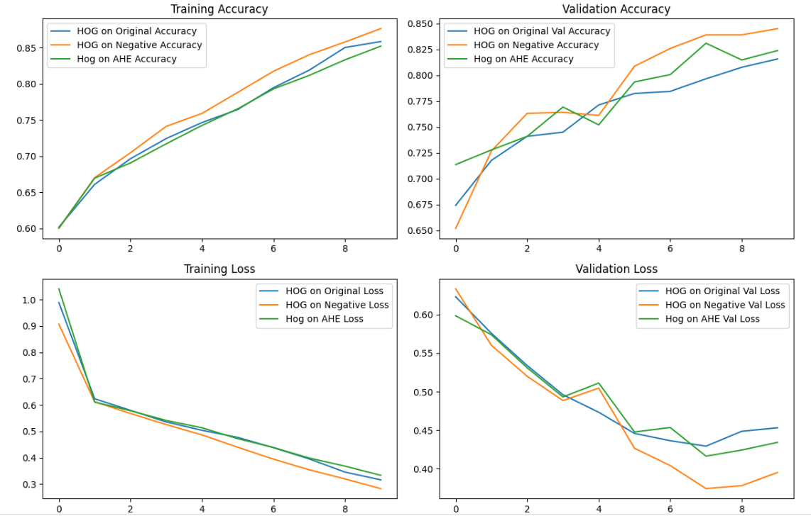
CNN

Slide 24
RESNET50 MODEL
Input
Conv2D(64 filters, 7X7, ReLu)+ BatchNormalization
MaxPooling2D (3X3)
Conv2D(64, 3X3) ->BatchNormalization -> ReLu
Conv2D(128, 3X3)->BatchNormalization->ReLu
Conv2D(256, 3X3) -> BatchNormalization -> ReLu
Conv2D(512, 3X3) ->BatchNormalization ->ReLu
Global Average Pooling(GAP)
Droupout(0.5)
Dense(2, Softmax)
Dense(1024,ReLu)
Output Layer

Slide 25
RESNET50
The Resnet model is applied on original images, negative and AHE images. (HOG – Overfitting Conditions)
Excellent performance, with test accuracy ranging from 96.67% to 97.84%.
Negative Images (97.84%) performed the best on the test set.
ResNet50 is generalizing well to unseen data.
 | Original Images | Negative Images | AHE Images
Train Set | 99.57 | 99.67 | 99.79
Test Set | 96.67 | 97.84 | 96.71

Slide 26
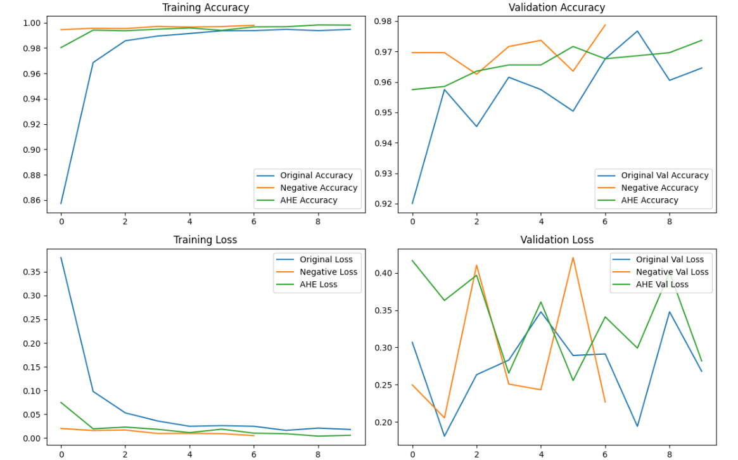
RESNET50 MODEL

Slide 27
Conclusion
Test accuracy up to 97.84% model can classify mammogram images into Benign (Non-Cancerous),Malignant (Cancerous)
Image preprocessing techniques, the Negative Image transformation performed the best, intensity inversion enhances important feature detection.
CNN model achieved a test accuracy of ~80%, ability to extract features well.
The low generalization gap (~2-3%) in ResNet50 indicates strong model robustness and minimal overfitting.

Slide 28
References
Almarri, A., Gupta, G., Kumar, R., Vandana, V., Asiri, F., & Khan, S. B. (2024). The BCPM method: Decoding breast cancer with machine learning. BMC Medical Imaging. https://doi.org/10.1186/s12880-024-01402-5
Breast Cancer Information, Support & Donations. (n.d.). National Breast Cancer Foundation. Retrieved February 2, 2025, from https://www.nationalbreastcancer.org/
Iniyan, S., Raja, M. S., Poonguzhali, R., Vikram, A., Ramesh, J. V. N., Mohanty, S. N., & Dudekula, K. V. (2024). Enhanced breast cancer diagnosis through integration of computer vision with fusion based joint transfer learning using multi modality medical images. Scientific Reports, 14(1), 28376. https://doi.org/10.1038/s41598-024-79363-6
Lee, R. S., Gimenez, F., Hoogi, A., Miyake, K. K., Gorovoy, M., & Rubin, D. L. (2017). A curated mammography data set for use in computer-aided detection and diagnosis research. Scientific Data, 4, Article number: 170177. Retrieved February 19th, 2025, from https://doi.org/10.1038/sdata.2017.177
Mohi ud din, N., Dar, R., Rasool, M., & Assad, A. (2022). Breast cancer detection using deep learning: Datasets, methods, and challenges ahead. Computers in Biology and Medicine, 149. https://doi.org/10.1016/j.compbiomed.2022.106073
Nassif, A. B., Talib, M. A., Nasir, Q., Afadar, Y., & Elgendy, O. (2022). Breast cancer detection using artificial intelligence techniques: A systematic literature review. Artificial Intelligence in Medicine, 127, 102276. https://doi.org/10.1016/j.artmed.2022.102276
Shen, L., Margolies, L. R., Rothstein, J. H., Fluder, E., McBride, R., & Sieh, W. (2019). Deep Learning to Improve Breast Cancer Detection on Screening Mammography. Scientific Reports, 9(1), 12495. https://doi.org/10.1038/s41598-019-48995-4
Wadhwa, G., & Kaur, A. (2020). A deep CNN technique for detection of breast cancer using histopathology images. 2020 Advanced Computing and Communication Technologies for High Performance Applications (ACCTHPA). https://doi.org/10.1109/ACCTHPA49271.2020.9213192
Zhang, B., Shi, H., & Wang, H. (2023). Machine learning and AI in cancer prognosis, prediction, and treatment selection: A critical approach. Journal of Multidisciplinary Healthcare, 16, 1779–1791. https://doi.org/10.2147/JMDH.S410301
Melek, A., Fakhry, S., & Basha, T. (2023). Spatiotemporal mammography-based deep learning model for improved breast cancer risk prediction. 2023 International Conference on Advanced Machine Learning (ICAML), https://ieeexplore.ieee.org/abstract/document/10340602.

Slide 29
Thank You

